Slide 1
Intro to Excel Week 2: Advanced Formulas
USC Annenberg Digital Lounge

Slide 2
After today’s session
Explain how to use VLOOKUP, XLOOKUP
Write a nested formula based on a scenario
Use formulas for cumulative functions

Slide 3
Today’s topics
Quick review of formula basics
Using AI for Excel help
VLOOKUP
XLOOKUP
Nesting formulas
Cumulative formulas

Slide 4
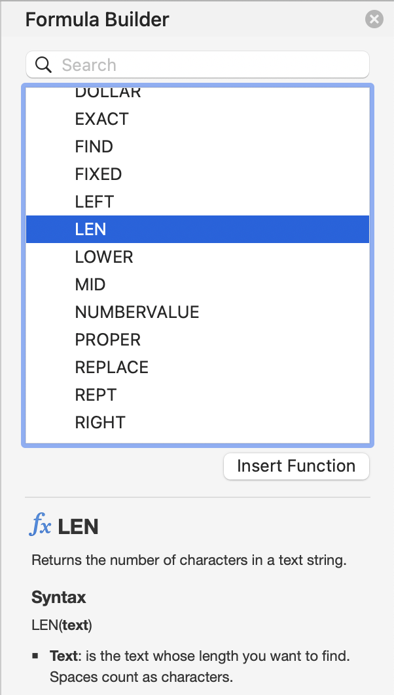
Formula basics review
Insert → Function to see the list of options
Syntax:
How many arguments
Meaning of each argument
Insert Function button
Or type =function(argument) in formula bar
=LEN(“your full name”)

Slide 5
Exercise from last time
Create a URL for each show, using formulas, written all in a single column, formatted as
www.netflix.com
Slash, the name of the show in all lower case, with no spaces
Example: www.netflix.com/loveisblind
Hint: start with each part in a separate column first!

Slide 6
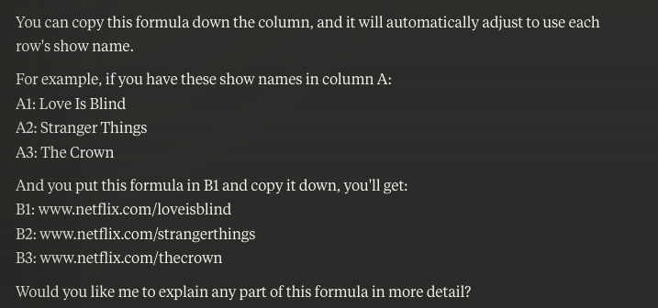
Get help from AI
=CONCATENATE("www.netflix.com/", LOWER(SUBSTITUTE(A1, " ", "")))

Slide 7
Rachel's Rules for using AI effectively
Always make sure you understand the formula it wrote
Can you explain it in your own words?
Always try the formula yourself and gut-check the results
Does the output look right on a few examples?
Always assume it's wrong and look at it critically
What are the logic steps you'd follow if you did this by hand? How do those compare to the formula?
Think of it as your first draft. Don't be afraid to revise it!

Slide 8
The problem to solve
You do marketing for a large network of 500 podcasts
You have a list of audio file uploads, and you want to know if every show you manage has uploaded their episode(s) for this week
You also need a list of all those episodes with the show title and audio file

Slide 9
What is VLOOKUP?
Given a value to search for, search for that value in another range
Return any value to the right of the searched value
Function arguments:
Lookup Value
Table Array
Column Index Number
Range Lookup – should almost always be “false”

Slide 10
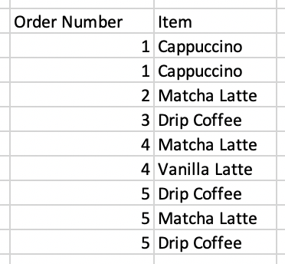
VLOOKUP example
Create a prices column next to the orders
Remember Absolute Cell Reference!

Slide 11
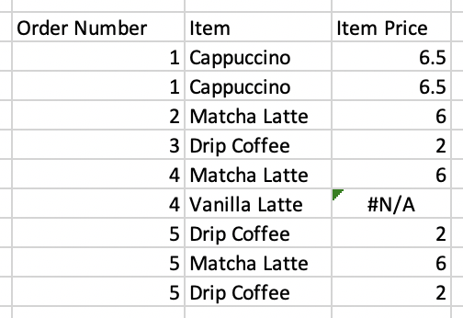
VLOOKUP example
Why is one item showing “#N/A”?

Slide 12
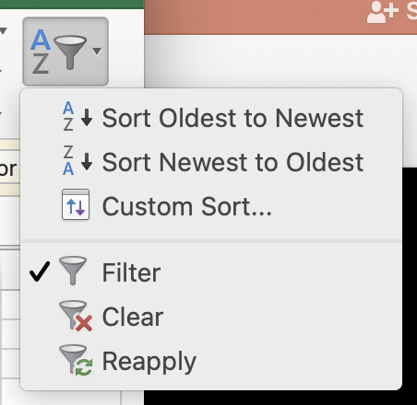
Ordering values
VLOOKUP will return the first value it finds in the list
In cases with multiple values, a good idea to sort the lookup range!
Recommended method:
Sort & Filter
Custom Sort…
Add a second level of sorting

Slide 13
Activity Part 1
Download this dataset: bit.ly/usc-fall24-excel2
Add a column to the shows sheet called “Upload Date”:
Use VLOOKUP
Be sure to get the earliest date, in the case of multiple uploads
Hint: sort the data you are looking up to!

Slide 14
Handling VLOOKUP errors
For VLOOKUP, most common reason to nest formulas is handling errors
Super useful formula for this:
=IFERROR(A2,”Not found in list”)

Slide 15
Review of nesting formulas
Best way to figure things out is to write each formula in its own column at first
Once you’ve checked that each column (intermediate step) looks right, you can combine
=SUBSTITUTE(“my full name”, “ “, “”)
=LEN(“myfullname”)
=LEN(SUBSTITUTE(“my full name”, “ “, “”))

Slide 16
Activity Part 2
Same dataset: bit.ly/usc-fall24-excel2
Add a nested formula to your VLOOKUP column
Replace not found errors with ”Not uploaded yet”
Add two columns to the Campaign Participation table using VLOOKUP and IFERROR:
Show title, from the shows sheet
Personal endorsement, from the campaigns sheet
Add another nested formula: If this is true, replace the value with “Personal endorsement is required”

Slide 17
VLOOKUP vs. XLOOKUP
On Excel newer than 2019, there is XLOOKUP… the next generation of VLOOKUP
Instead of only handling values to the right of your lookup value, XLOOKUP has more flexibility, AND can bring in multiple columns at once, AND can handle errors!
=IFERROR(VLOOKUP(M13,$I$12:$J$15,2,FALSE),”Missing”)
=XLOOKUP(E3, $A$2:$A$5, $B$2:$B$5, “missing”)

Slide 18
What is XLOOKUP?
Function arguments:
Lookup Value
Lookup Array
Return Array
Optional: If Not Found
Optional: Match Mode

Slide 19
Activity Part 3
Same data source: bit.ly/usc-fall24-excel2
Add another column to your Show Participation table, called Show Title XLOOKUP, where you re-write your VLOOKUP from the previous exercise to get the show title using XLOOKUP instead

Slide 20
Cumulative Formulas
For each row, apply a formula to all of the rows preceding that row
Key is absolute cell references
=SUM(F$2:F15)

Slide 21
Activity part 4
On the Campaign Participation sheet, add a column with each show’s monthly downloads number, using VLOOKUP
Then, use a row-based formula to calculate the monthly revenue for each row in campaign_participation
Hint: Revenue = CPM*(downloads/1000)
Then, add a Cumulative Revenue column to the Campaign Participation sheet

Slide 22
Best Practices for Lookup Formulas
The lookup array should ideally be a unique identifier, like a case-sensitive ID, or an email address, to avoid incorrect matches
If you’re not sure if an ID is unique, use conditional formatting -> Highlight Duplicates in that column to check
Make sure your data is sorted based on your use case, if you are going to be returning the first of multiple values

Slide 23
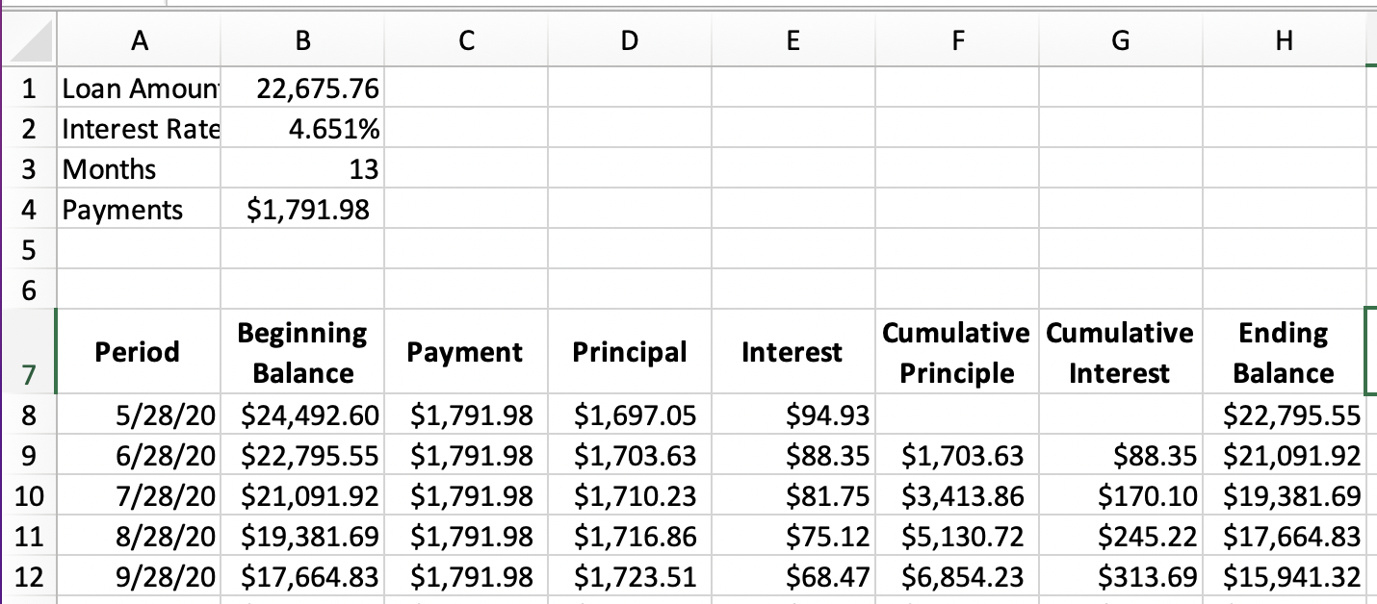
Specialized Formula Example: Loan Payments
PMT formula
Absolute cell references
Cumulative formulas

Slide 24
Upcoming sessions
Charts and Tables
Dashboards
Good Excel learning tools:
Miss Excel (IG/TikTok)
PolicyViz (email/website)
Exceljet (reference site)

