Slide 1
Intro to Excel Week 1: Formulas + Formatting
USC Annenberg Digital Lounge

Slide 2
Nice to meet you!

Slide 3
What have you used spreadsheets for?

Slide 4
After today’s session
Organize data using editing features and cleanup tools
Explain how to set up a formula and configure formatting
Categorize data using drop-down menus

Slide 5
Today’s topics
Conditional formatting
Data validation
Cell and table formatting
Basic formulas for numbers, text, dates
Logic formulas using if and case
Data for today: netflix.com/tudum/top10/ Download the “Most Popular” List in Excel format

Slide 6
Excel vs. Google Sheets
Most commonly-used features in Excel also exist in Google Sheets
The names may be slightly different
Same is true for Mac vs. PC
There are slight variations in menus and keyboard shortcuts

Slide 7
Cell Formatting
Often, will automatically be correct
Sometimes, will not make sense
Use the Number Format dropdown in the Home Ribbon
Advanced options under More for specific dates, negatives
Enter 75 into any cell. Use the Number Formats menu to change it to:
Short Date
Text
Number

Slide 8
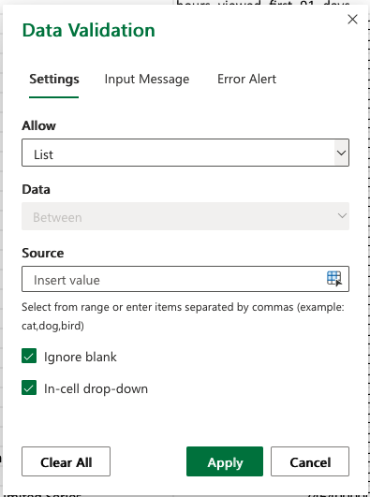
Data Validation
Asking others to input information
Coding or categorizing rows manually
Data ribbon → Data Validation
Allow: List
Type Seen,Haven't seen into the source values
Apply

Slide 9
Activity Part 1
netflix.com/tudum/top10/ - Download the “Most Popular” List in Excel format
Create new another column:
A column that called “Seen” with a dropdown menu for “No”, “No but on my list”, “Yes and loved it”, ”Yes and didn’t love it”
Add an error message to the validation
Fill out the field on a few rows to make sure it works!

Slide 10
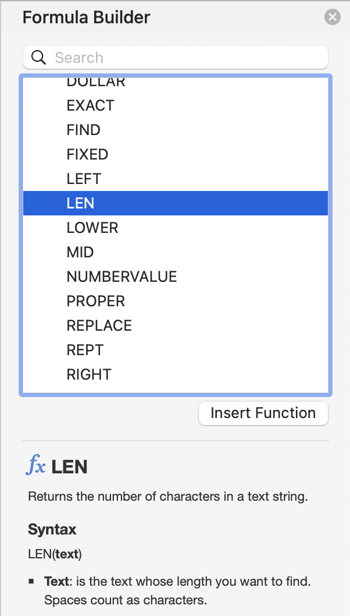
Writing Formulas
To see the list of options
365: Formulas > Insert Function
Mac: Insert > Function
Syntax:
How many arguments
Meaning of each argument
Insert Function button
Or type =function(argument) in formula bar
=LEN(“your full name”)

Slide 11
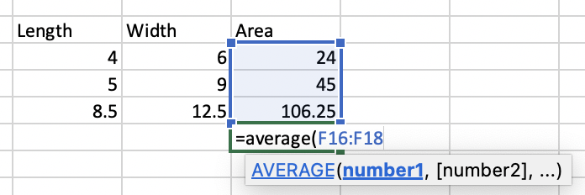
Math Formulas
Row-based formulas (“about the row, in the row”)
+, -, *, /, ^
Column-based formulas (summarize)
Count, sum
Average
Minimum
Maximum
Percentiles

Slide 12
Date Formulas
TODAY()
Number of days
Extract parts of dates
Formatting dates
=TODAY()
=TODAY()-“2024-01-01”
Find the number of days until your birthday

Slide 13
Text Formulas
Concatenate
Left
Right
Substitute
Proper, upper, lower
=CONCATENATE(“Cardi”, “ ”, “B”)
=PROPER(A2)

Slide 14
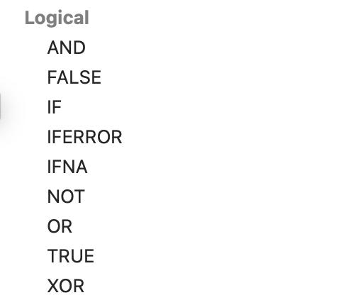
Logic Formulas
Row-based logic
If the student attended at least one class, in week one or week two, count them as total students
=OR(A2,B2)
=IF(A2>B2,“Eligible”, “Not Eligible”)

Slide 15
Activity Part 2
netflix.com/tudum/top10/ - Download the “Most Popular” List in Excel format
Create new columns (hint: use formula builder!):
A category column that substitutes the word “Films” with “Movies”
A column with the first 3 letters of each piece of content
For the TV shows, create a new column with the show title (in all caps) followed by a “-” followed by the season title
Views per day for first 91 days for each show
Column that is True if Hours Viewed is over 200,000,000, and false otherwise

Slide 16
Logic Formulas
Column-based (summarize)
CountIf
SumIf
CountBlank
=COUNTIF(F2:F15,">2")
=SUMIF(F2:F15,">2",G2:G15)

Slide 17
Activity Part 3
Same data source: netflix.com/tudum/top10
Find:
Sum of hours viewed
Average runtime, converted to minutes
For each of the 4 categories, the average runtime in hours
Use SumIf to find the total views for content ranked 1-5
Percentage of content with runtime greater than 2 hours
Then Format As Table (from the Home ribbon, pick your favorite)

Slide 18
Combining formulas
Best way to figure things out is to write each formula in its own column at first
Once you’ve checked that each column (intermediate step) looks right, you can combine
=SUBSTITUTE(“my full name”, “ “, “”)
=LEN(“myfullname”)
=LEN(SUBSTITUTE(“my full name”, “ “, “”))

Slide 19
Activity part 4
Create a URL for each show, using formulas, written all in a single column, formatted as
www.netflix.com
Slash, the name of the show in all lower case, with no spaces
Example: www.netflix.com/loveisblind
Hint: start with each part in a separate column first!

Slide 20
Upcoming sessions
Advanced Formulas
Charts and Tables
Dashboards
Good Excel learning tools:
Miss Excel (IG/TikTok)
PolicyViz (email/website)
Exceljet (reference site)

