Slide 1
Intro to Excel Week 3: Charts and Tables
USC Annenberg Digital Lounge
Today's dataset: bit.ly/usc-fall24-excel3

Slide 2
After today’s session
Create and modify a pivot table
Select an effective chart type based on a scenario
Understand static vs. pivot charts
Format charts effectively with layouts and labeling

Slide 3
Today’s topics
Define and create a table and chart
Define and create a pivot table and pivot chart
Named ranges and labeling
Conditional formatting

Slide 4
Covered so far
Data formatting basics
Data validation
Basic formulas
Combining formulas
VLOOKUP and XLOOKUP

Slide 5
The problem to solve
You do marketing for a large network of 500 podcasts
For each category of our shows, find the average number of downloads per month

Slide 6
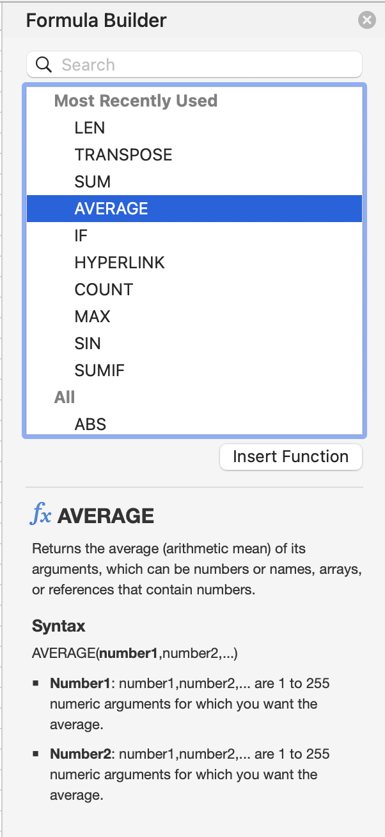
Formula basics review
Insert → Function to see the list of options
Syntax:
How many arguments
Meaning of each argument
Insert Function button
Or type =function(argument) in formula bar
=AVERAGE(D:D)
=COUNTIF(F2:F15,">2")
=SUMIF(F2:F15,">2",G2:G15)

Slide 7
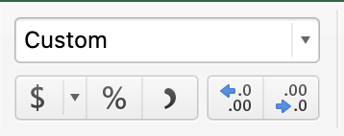
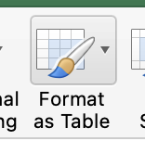
Best practices for tables
Clear header for every column
Format numbers
Units, decimals, commas as needed
If it’s not fractional, don’t display decimals
Use Format as Table on your final product

Slide 8
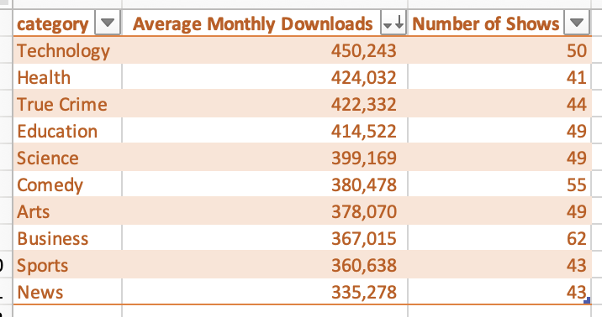
Activity Part 1
Download this dataset: bit.ly/usc-fall24-excel3
Create a summary table with these steps:
Create a new sheet (tab) in your workbook called Summary
Select all the categories and paste them into your new sheet
Use the Remove Duplicates tool to create a list of categories
Display how many shows are in each category using COUNTIF
Display the average monthly downloads for each category using AVERAGEIF
Sort by the average downloads, descending
Format as table, be sure to add clear headers!

Slide 9
Why pivot tables?
They accomplish the same thing we just did, but way more easily and faster!
The formulas we just did are conceptually the same thing that the pivot table will do
AND, pivot tables add a lot of helpful other features!
Quickly change summary without re-writing a formula
Change display format

Slide 10
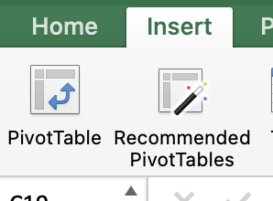
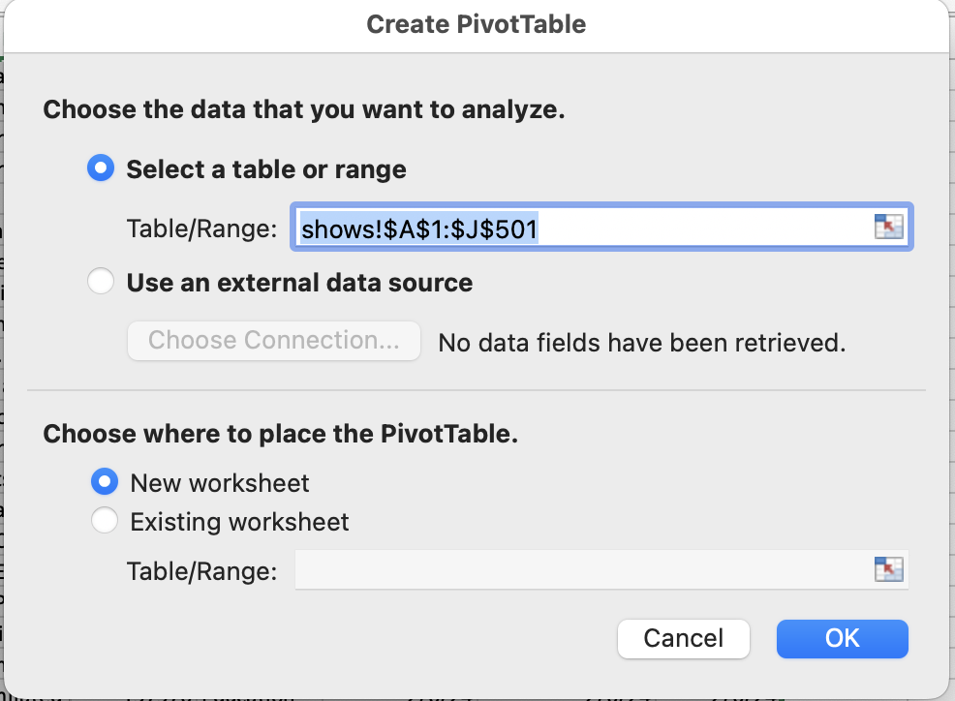
To create a pivot table
Select all your data
Click one cell of your data, then Cmd-A / Ctrl-A
Insert → PivotTable
Double-check your range makes sense
Choose PivotTable location (usually new worksheet)

Slide 11
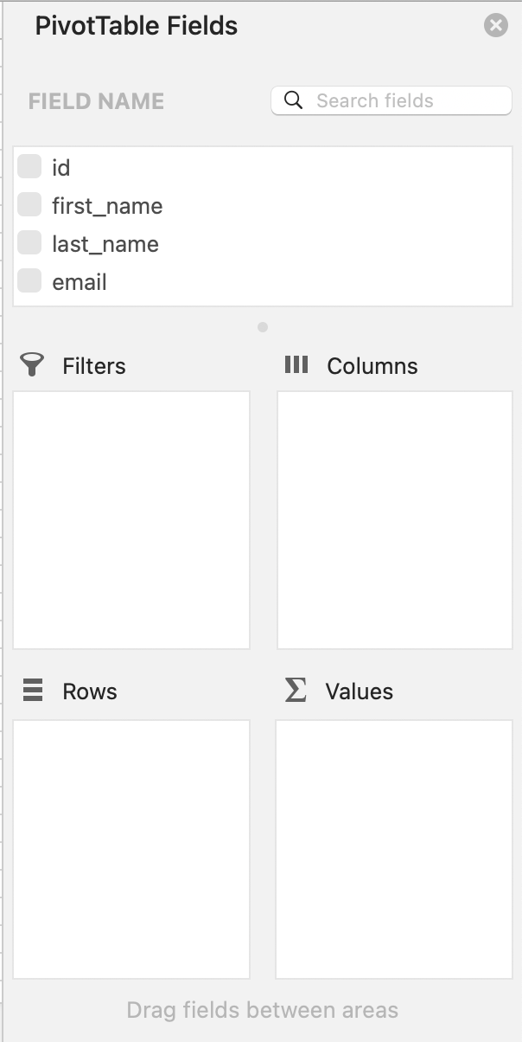
Build your pivot
Field List lists all the columns from your source sheet
Drag and Drop those columns into the 4 parts of the pivot table
Rows
Values
For simple pivots, you can skip columns and filters
See the results of your changes immediately to the left!

Slide 12
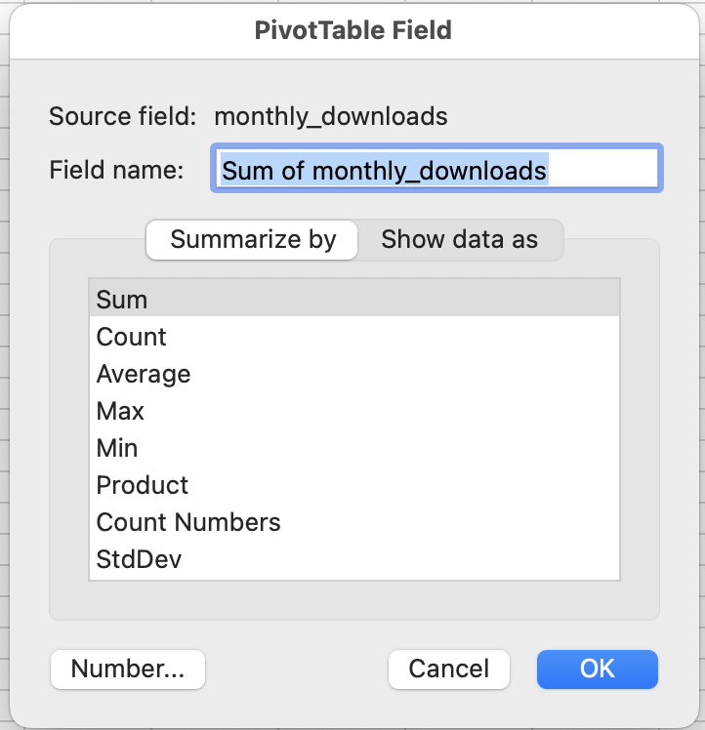
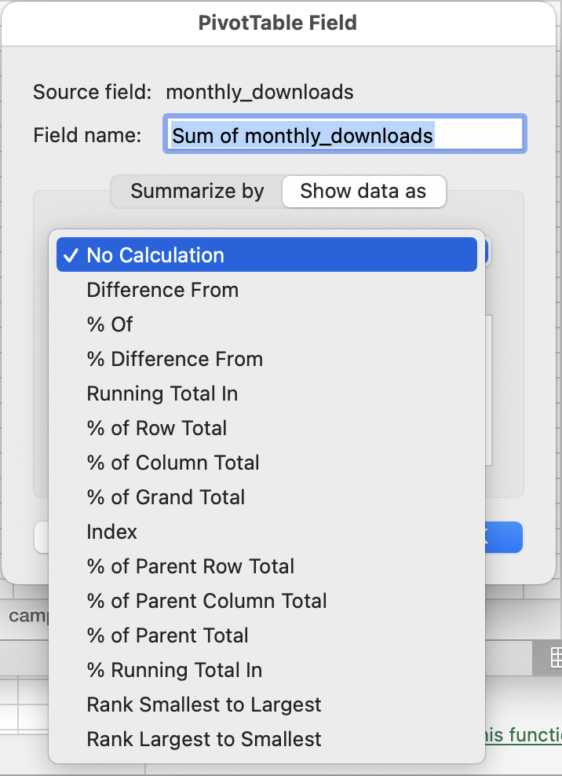
Customize your pivot
Click the “i” icon next to a field name to set the formatting
Pop-up will give you options to:
Summarize By
Show Data As
See the results of your changes immediately to the left!

Slide 13
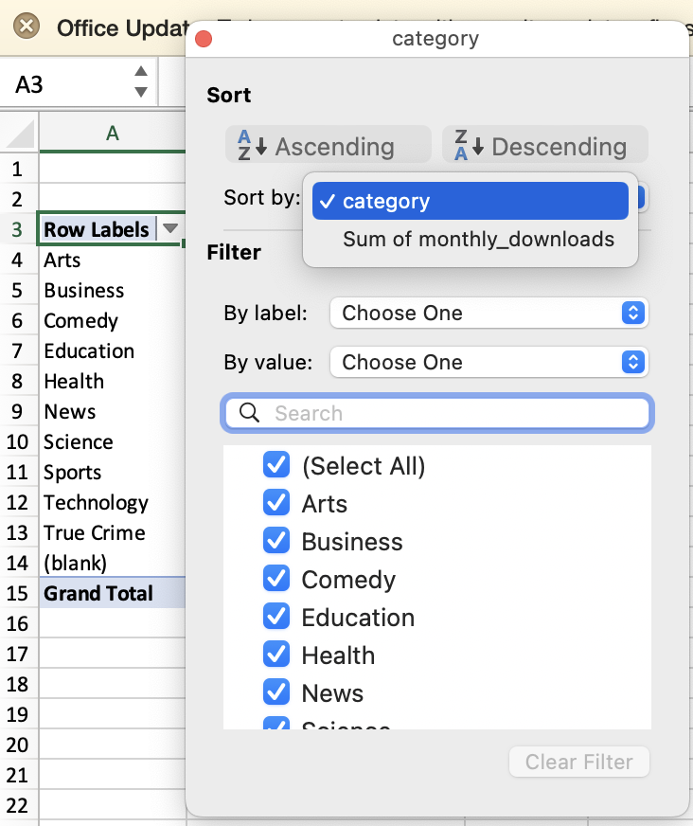
Sort your pivot
Click the 🔽 next to “Row Labels” for smart sorting options
Change “sort by” to sort by any column values

Slide 14
Activity Part 2
Same dataset: bit.ly/usc-fall24-excel3
Create a PivotTable to show the same result as Part 1 (for each category, average number of downloads, and total number of shows)
Change the number of shows column to display the percent of total
Add a second row split by Release Day.
Also try Release Day as a column, see which you like better!
Use a pivot table to find: How many total monthly downloads do we get from News shows that are released on Wednesdays?

Slide 15
Pivot table tips
Whenever you click into your pivot table, you get two new sections of the top ribbon: Analyze and Design
Field List on the top right will show/hide the builder view
Design tab lets you set colors, grand totals, etc.

Slide 16
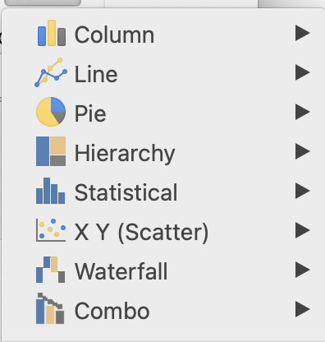
Adding a pivot chart
From the Analyze ribbon, click PivotChart
A chart will automatically populate!
You’ll get more new ribbons at the top: PivotChart Analyze and Design
Under Design, you can:
Change Chart Type
Quick Layout
Add Chart Element
Change Colors

Slide 17
Non-pivot charts
Everything we just talked about to insert a chart can be done from a static non-pivot table, like the one we did at the beginning
Select all data (Cmd-A / Ctrl-A) and use Insert → Chart
These require a lot more manual formatting
Like tables – if you need a chart, it’s usually best to do a pivot chart instead of a regular chart!

Slide 18
Activity part 3
Same dataset
Create a pivot chart from your pivot table
Change the Chart Type, Layout, and Colors until you have a chart you like
Give it a descriptive title
Just for fun: create a regular chart from your non-pivot table from part 1.

Slide 19
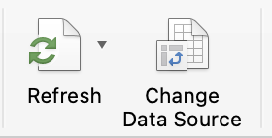
Adding or editing data in a pivot table
If you add or edit any data in the source sheet of your pivot table, the chart will not automatically update until you refresh
Click the Refresh button in the Analyze tab
Excel only! GSheets automatically updates
If you add rows to your source data, use Change Data Source to update the range
Once the pivot table is refreshed, the pivot chart will auto-update!

Slide 20
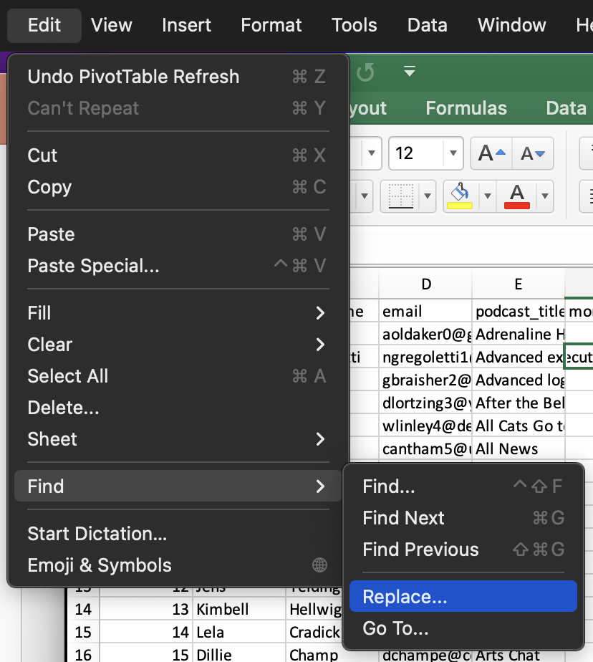
Activity part 4
On the shows source tab, use Edit → Find → Replace to change the cells “Technology” to “Tech”
Refresh your pivot table to reflect the change
Add a row to your dataset with a fake podcast and change the data source so that it’s included in your pivot table
Go back to your original table from part 1 – notice the error?

Slide 21
When to use which type of chart
What is the point I’m trying to make to my audience?
“Our top categories of shows are Tech and Business”
“All major categories are represented in our shows”

Slide 22
Upcoming sessions
Excel Dashboards
Later this semester: SQL and Python!
Good Excel learning tools:
Miss Excel (IG/TikTok)
PolicyViz (email/website)
Exceljet (reference site)
Rachel Whaley
linkedin.com/in/rachelrwhaley

