Slide 1
Intro to Excel Week 4: Dashboards
USC Annenberg Digital Lounge
Today's dataset: bit.ly/usc-fall24-excel4

Slide 2
After today’s session
Design a data dashboard to answer questions about the data
Build the dashboard you designed by using your knowledge of formatting, formulas, charts, and tables

Slide 3
Today’s topics
Designing your dashboard to meet client requirements
Building the elements of your dashboard
Dashboard layout
Interactive features
Collaboration and iteration

Slide 4
Covered so far
Data formatting basics
Conditional formatting
Data validation
Basic formulas
Combining formulas
VLOOKUP and XLOOKUP
Static tables
Pivot tables
Pivot charts

Slide 5
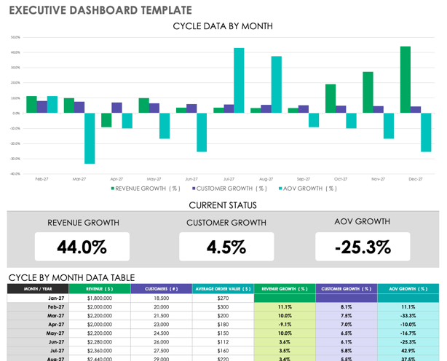
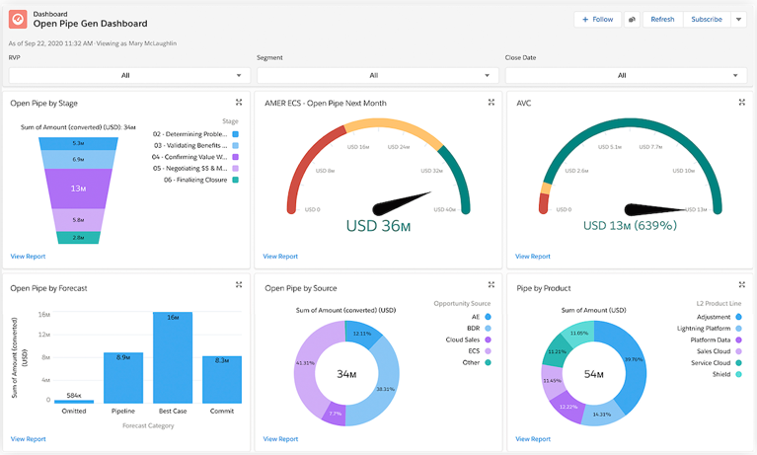
What is a dashboard?
Tells a story to provide details, prompt action, or answer questions

Slide 6
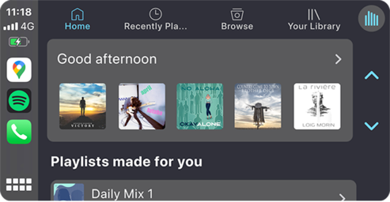
Dashboard styles
Display Dashboards: Summarize required info in a single view
Action Dashboards: Act as a ”to-do” list
Toolbox Dashboards: Give a set of filters and options for the user to explore
Action Dashboard
}
Toolbox Dashboard
Display Dashboard

Slide 7
Develop your dashboard POV
What question should this dashboard answer?
What action should be taken by a viewer of this dashboard?
What decisions should this dashboard inform?

Slide 8
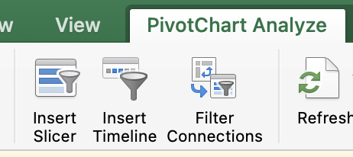
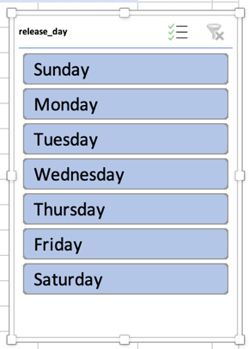
Adding interactive features
Especially for toolbox dashboards, add easy filtering tools
To add a slicer (visual filter, more user friendly):
Click into your chart → ribbon under PivotChart Analyze → Insert Slicer → choose your attribute(s)
For date fields, Insert Timeline works similarly
To add a filter to a PivotTable:
Click into your table → field list on the right → drag a field into the Filter section

Slide 9
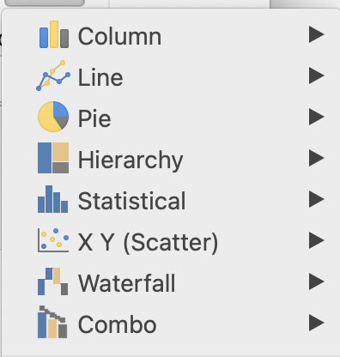
Sketching out your dashboard
Get clear on the requirements
Brainstorm what types of charts or tables might make sense to display the required information
Over time?
Parts of a whole?
Comparison?
Single number?
Set up a draft pivot table to see if you can accomplish the summaries you need

Slide 10
Your project
You are a Marketing Analyst for a large network of 500 podcasts
Is this a display, action, or toolbox dashboard?
The COO of the network has asked you to create a dashboard to track the company’s top key metrics related to revenue
Monthly downloads by podcast content category
The top 5 advertisers in 2023 by revenue
Cumulative revenue so far this year, compared to last year
One more stat or chart you think the COO might like to see

Slide 11
By the end of this session, you'll have something like this!

Slide 12
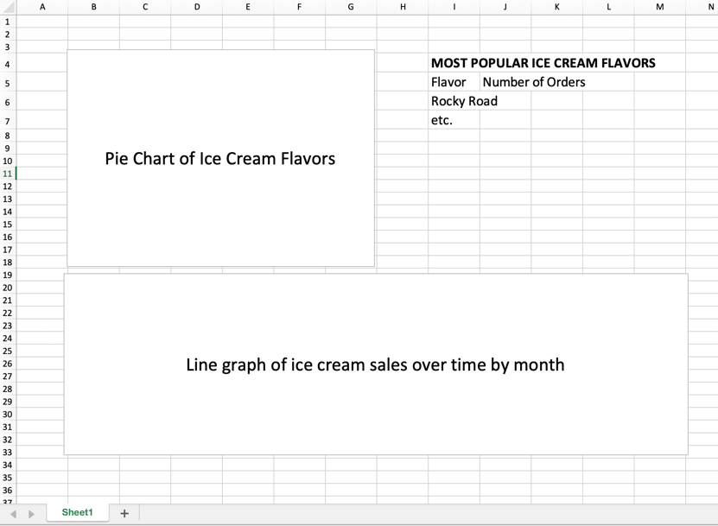
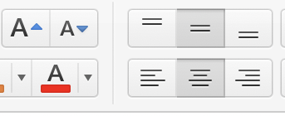
Sketch out initial design
Use text boxes to roughly lay out your desired end product
You can also just type, for tables!
From ribbon, Insert → Text Box
In your text box, helpful to center and enlarge the text

Slide 13
Activity Part 1
Download this dataset: bit.ly/usc-fall24-excel4
Sketch out (”whiteboard”) a very rough outline of your dashboard:
Create a new sheet (tab) in your workbook
Use Text Boxes to roughly sketch out how you’d like your final dashboard to look (at least 1 chart, at least 1 table)
Create a pivot table and play around with drag and drop to find the data layouts you might want to use
The COO of the network has asked you to create a dashboard to track the company’s top key metrics related to revenue
Monthly downloads by podcast content category
The top 5 advertisers in 2023 by revenue
Cumulative revenue so far this year, compared to last year
One more stat or chart you think the COO might like to see

Slide 14
Get started building
Each item in your dashboard is called a component
Work on one component at a time
Sometimes easiest to work on each in its own sheet
To create a chart, create a pivot table first, to make sure data is grouped correctly
To create a single stat (e.g. overall total, average, etc.) you can type a formula directly into a cell
Add enough labels/titles that you know what each component is
Don’t worry about colors or specific formatting yet

Slide 15
Activity Part 2
Download this dataset: bit.ly/usc-fall24-excel4
Build a rough draft of your dashboard:
Create a first stab at a chart/table for each of your components
Don’t worry about layout or formatting yet
The COO of the network has asked you to create a dashboard to track the company’s top key metrics related to revenue
Monthly downloads by podcast content category
The top 5 advertisers in 2023 by revenue
Cumulative revenue so far this year, compared to last year
One more stat or chart you think the COO might like to see

Slide 16
Dashboard components -- hints!
Monthly downloads by podcast content category
Pivot Table
Optional: Pivot Chart
3. Cumulative revenue so far this year, compared to last year
In 2024 sheet, use DATE formula to convert months to dates
Add revenue formula
Sort both by date
Create 2 charts, or a chart with 2 series
2. The top 5 advertisers in 2023 by revenue
Xlookup to get show downloads
Formula to get spend (Revenue = CPM*(downloads/1000)
Pivot Table (optional chart!)
4. One more stat or chart you think the COO might like to see
What questions do you have about these podcasts or their revenue?
By show? By month? By advertiser? By campaign?

Slide 17
Adding interactive features
Especially for toolbox dashboards, add easy filtering tools
To add a slicer (visual filter, more user friendly):
Click into your chart → ribbon under PivotChart Analyze → Insert Slicer → choose your attribute(s)
For date fields, Insert Timeline works similarly
To add a filter to a PivotTable:
Click into your table → field list on the right → drag a field into the Filter section

Slide 18
Activity Part 3
Make your dashboard interactive!
Bring all your components into one sheet
Add at least one filter and at least one slicer to your dashboard
The COO of the network has asked you to create a dashboard to track the company’s top key metrics related to revenue
Monthly downloads by podcast content category
The top 5 advertisers in 2023 by revenue
Cumulative revenue so far this year, compared to last year
One more stat or chart you think the COO might like to see

Slide 19
Considerations for layout
What question should this dashboard answer?
What action should be taken by a viewer of this dashboard?
What decisions should this dashboard inform?
How do these answers inform your design?
Priority order
Chart vs. table
Colors

Slide 20
Formatting each component
Consistent overall styling
Doesn’t have to be all same colors, but choose a consistent palette
Every component should have:
A title
Labeled axes (if a chart)
Units (on numbers)
A legend or data point labels or both
If it’s a more complicated chart or table, a short bit of explanatory text alongside it (typed in a cell or in a text box)
Make sure components are sized appropriately relative to each other

Slide 21
Formatting your dashboard
Size components to fit to your screen if possible
If scrolling is a must, scrolling down is more user-friendly than scrolling right
Key elements to include (in text boxes or typed in cells):
A title (something memorable is always good!)
A purpose statement (1-2 sentences related to your dashboard POV)
Your name and contact info
The data source (even if it’s “internal company database”)
The Last Updated Date
Consistent style and fonts
If desired, hide gridlines from the ribbon under View → Gridlines

Slide 22
Organizing your sheets
In the final workbook, your first sheet should be labeled “Dashboard” or similar
All sheets should be labeled, things like:
Raw
Pivot
Analysis
Draft
If you want a pivot chart without a table, keep the table off the main dashboard tab

Slide 23
Activity part 4
The COO of the network has asked you to create a dashboard to track the company’s top key metrics related to revenue
Monthly downloads by podcast content category
The top 5 current advertisers in 2023 and their revenue
Cumulative revenue so far this year, compared to last year
One more stat or chart you think the COO might like to see
Format your dashboard:
Your dashboard should state somewhere:
A title (something memorable is always good!)
A purpose statement (1-2 sentences related to your dashboard POV)
Your name and contact info
The data source (even if it’s “internal company database”)
The Last Updated Date
Clean up sizing, colors, titles, etc. and send me a screenshot! Send to whaleyr@usc.edu

Slide 24
Maintaining Excel dashboards
Remember that when you update source data for a pivot table, you have to click Refresh in the Analyze ribbon to reflect the updates
Always update the Last Updated Date, and add date at end of filename
If you’re doing really frequent updates or sharing the same spreadsheet with a lot of people, you might need to upgrade to a more official database/dashboard tool…

Slide 25
Learn more about data!
SQL and Python for Data Analysis
Week 1 (10/21): Intro to SQL
Week 2 (11/4): Data Modeling with SQL
Week 3 (11/18): Intro to Python
Week 4 (11/25): Analyzing Data with Python
Week 5 (12/2): Analytics & Visualization with SQL and Python
Feel free to keep in touch!
linkedin.com/in/rachelrwhaley
whaleyr@usc.edu
Good Excel learning tools:
Miss Excel (IG/TikTok)
PolicyViz (email/website)
Exceljet (reference site)

